Slide 1
Delta Review for SNPP OMPS SDR Earth View Products
Fuzhong Weng
OMPS SDR Team
NOAA/NESDIS/STAR
August 17, 2015

Slide 2
Outlines
OMPS SDR Team Members
Products and Users
Past Reviews of OMPS EV SDR and Issues
Declaring OMPS EV Validated Maturity
Requirements and Performance
Milestones since Provisional Maturity
Other Accomplishments
Path Forward for SNPP
Supporting Materials

Slide 3
OMPS SDR Team
PI Name | Organization | Primary Roles
Fuzhong Weng | NOAA/STAR | Budget and coordination; instrument and product performance monitoring; TOMRAD/VLIDORT modeling
Chunhui Pan | NOAA/STAR | NOAA Technical Lead; OMPS SDR cal/val science, code development, TVAC data analysis; SDR algorithm.
Glen Jaross | NASA | Instrument scientist; TVAC data acquisition and analysis; SDR algorithm.
Maria Caponi | Aerospace | Algorithm changes coordination; DR and issues tracking
Sarah Lipscy | BATC | Instrument sciences; prelaunch test; Sensor Characterization Data Bases (SCDB)
Wael Ibrahim | Raytheon | IDPS operations

Slide 4
Products and Users
Products
OMPS nadir mapper (NM) and nadir profiler (NP) earth view (EV) and calibration (CAL) SDR in both nominal and diagnostic mode.
Users
OMPS EDR Team (NCEP assimilates OMPS EDR)
Broader and future users via CLASS

Slide 5
OMPS EV SDR Maturity Review and Issues
Beta maturity since March 2012
Provisional maturity since 1 March 2013
Resolved all three issues recommended before EV SDR became provisional – weekly update darks, resolved negative smear and applied stray light correction for NM
Validated maturity review December, 2013 and Delta review June 2014.
Recommend to resolve two issues before EV SDR becomes validated:
Improve cross-track effects in NM (aka scan direction dependent error).
Improve stray-light correction in NP

Slide 6
Milestones since Provisional Maturity
Improved cross-track effects in NM. The current NM normalized EV radiance meet the SDR product requirement (bias < 2.0%).
Updated wavelength LUT and solar flux LUT
Validated wavelength dependent cross-track irradiance error from solar observation data
Validated wavelength dependent cross-track normalized radiance error from SDR EV data via. TOMRAD
Validated cross-track SO2 index variation from NM EDR data
Re-evaluated NP straylight correction. SDR and EDR teams concurs that current stray light LUT provides adequate calibration for NP.
The NP stray light calibration LUT was in operation in March 2014.
6

Slide 7
Other Accomplishments
Instrument and SDR performance monitoring, characterization, and improvement.
Improvement of EV normalized radiance consistency between NP and NM by 2-10% in 300-310 nm.
Instrument cal/val support (e.g., orbit adjustment, anomaly resolution)
Complete documentation (Users’ Guide)
Weekly dark LUTs update and delivery
CCR 2546, 7825 and 7826 modified CDFCB and xml files
CCR 2548 NP radiometric LUTs updated and delivered
SDR software improved: stray light correction

Slide 8
Declaring OMPS EV SDR Validated Maturity
OMPS EV SDRs meet SDR performance requirement as well as EDR products requirement
The cross-track direction radiance accuracy meets spec and the error is less than 2.0% with updated wavelength and day one solar LUTs
The NM and NP consistency in 300-310 nm has been improved by 2-10% with updated radiance calibration coefficients
Sensor orbital performance is stable and meet expectation
OMPS EV SDRs have following features
On-orbit sensor performance is characterized
SDR product uncertainties are defined for representative conditions
Calibration parameters are adjusted according to EDR requirement
High quality documentation is completed
SDR data is ready for applications and scientific publication
Both OMPS NM and NP EV SDR should be declared as
validated-maturity products, effective August 20th 2015 !

Slide 9
NM Requirements and Performance
Budget Term | Requirement/Allocation | On-Orbit Performance
Non-linearity | < 2% full well | < 0.40%
Non-linearity Accuracy | < 0.2% | < 0.2%
On-orbit Wavelength Calibration | < 0.01 nm | <0.01 nm
Stray Light NM Out-of-Band + Out-of-Field Response | ≤ 2 | ≤ 2%
Intra-Orbit Wavelength Stability | Allocation (flow down from EDR error budget) = 0.02 nm | ~ 0.006 nm
SNR | 1000 | > 1000
Inter-Orbital Thermal Wavelength Shift | Allocation (flow down from EDR error budget) = 0.02 nm | ~0.006 nm
CCD Read Noise | 60 –e RMS | < 25 –e RMS
Detector Gain | 46 | 51
Absolute Irradiance Calibration Accuracy | < 7% | < 7% for most of the channels
Absolute Radiance Calibration Accuracy | < 8% | < 8%
Normalized radiance Calibration Accuracy | < 2% | < 2%

Slide 10
NP Requirements and Performance
Budget Term | Requirement/Allocation | On-Orbit Performance
Non-linearity | < 2% full well | < 0.3%
Non-linearity Accuracy | < 0.2% | < 0.2%
On-orbit Wavelength Calibration | < 0.01 nm | ~0.02 nm
Stray Light NP Out-of-Band + Out-of-Field Response | ≤ 2 | ≤ 2% for most of the channels
Intra-Orbit Wavelength Stability | Allocation (flow down from EDR error budget) = 0.02 nm | ~ 0.02 nm
SNR | 45-400 channel dependent | meet requirement
Inter-Orbital Thermal Wavelength Shift | Allocation (flow down from EDR error budget) = 0.02 nm | ~0.02 nm
CCD Read Noise | 60 –e RMS | < 25 –e RMS
Detector Gain | 43 | 47
Absolute Irradiance Calibration Accuracy | < 7% | < 7% for most of the channels
Absolute Radiance Calibration Accuracy | < 8% | < 8%
Normalized radiance Calibration Accuracy | < 2% | < 2%

Slide 11
Path Forward for SNPP Further Improvement
Continue instrument and SDR performance monitoring, characterization, and improvement.
Support instrument cal/val (e.g., orbit adjustment, anomaly resolution)
Carry out intra-orbital wavelength correction
Transition from CAL SDR operation to GRAVITE.
More comprehensive radiative transfer simulations at shorter wavelengths

Slide 12
Supporting Materials for Declaring OMPS EV SDR Validated Maturity Products
12

Slide 13
Building on-Orbit Truth for Estimating OMPS Earth View SDR Accuracy
Develop the “truth” simulated from the forward radiative transfer model at OMPS EV location (Macropixel)
Radiative transfer model must include comprehensive scattering and absorption processes at UV regions
Accurate understanding of atmospheric and surface status at OMPS EV location.
The difference between observations and simulations is used as an estimate of on-board calibration accuracy
13

Slide 14
OMPS EV Radiative Transfer Simulations
TOMRAD-2.24: TOMS (Total Ozone Mapping Spectrometer) Radiative Transfer Model
Rayleigh scattering atmosphere with ozone and other gaseous absorption
Spherical correction for the incident team
Molecular anisotropy and Raman scattering
Inputs to TOMRAD
Wavelength, solar and satellite viewing geometry, surface albedo, temperature and ozone profile
Climatology temperature profile
Ozone profile from Aura Microwave Limb Sounder (MLS)
Collocated OMPS/MLS data generated at NASA
Outputs from TOMRAD
Normalized radiance (NR=reflected radiance/solar flux) or N-Value (N=-100*log₁₀NR)
14

Slide 15
Co-located OMPS/MLS Temperature and Ozone Profiles

Slide 16
Simulated Normalized Radiance at OMPS Macropixel Position 19
Normalized Radiance
Observation - Simulation (O-B)
(O-B)₁₉ - (O-B)₁₈

Slide 17
Relative Error
Observation minus Simulation (O-B)
Relative error wrt to Position 18 (nadir)
The bias in cross-track direction is generally less than 2% except at shorter wavelengths where simulations may become less accurate due to complex scattering process. The bias is also larger in side pixel locations

Slide 18
Observation minus Simulation at Wing Positions
The biases at far wing positions (1-4 and 33-36) are out of specifications at wavelengths less than 320 nm. The causes can be related to complex RT processes, etc.

Slide 19
Observation minus Simulation near Center
The biases near center all meet specifications at all wavelengths

Slide 20
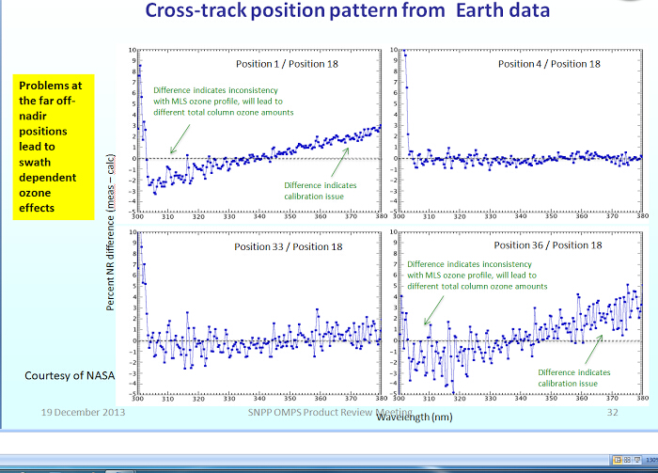
Observation minus Simulation (NOAA vs. NASA)
The bias characteristics simulated from NOAA (left red curves) and NASA (left blue curves) are consistent in cross-track direction and wavelength domain.

Slide 21
Error vs. Scan Position

Slide 22
e
Cross-Track Difference
for Earth View N-Value or Radiance
Wavelength-dependent Cross-Track Normalized Radiance Error Meets Requirement
Normalized radiance error is percent difference between OMPS and MLS via. TOMRAD
Figures shows the errors for 6 different cross-track (CT) positions
Errors were minimized < 2% for most of the channels.
Except ion is CT#36 on wavelength > 360 nm. Soft calibration are being implemented to eliminate this residual error.
CT position #1
CT position #9
CT position #19
CT position#26
CT position#35
CT position #36
Wavelength-dependent normalized radiance errors are within 2% (except for FOV 36)
which meets the performance requirement.

Slide 23
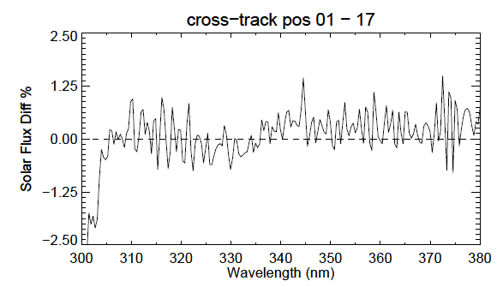
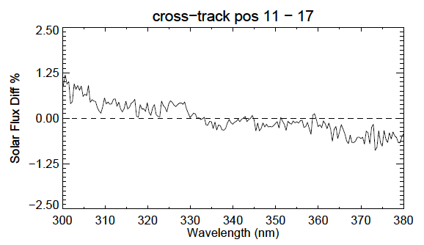
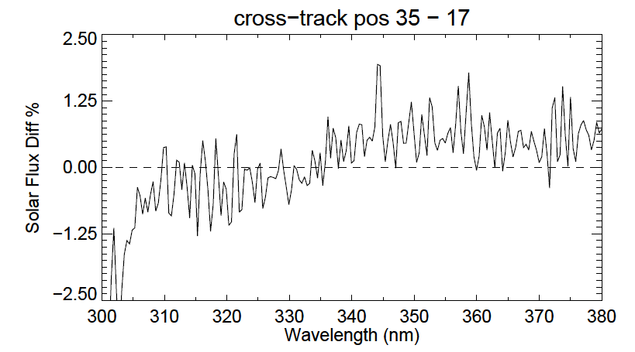
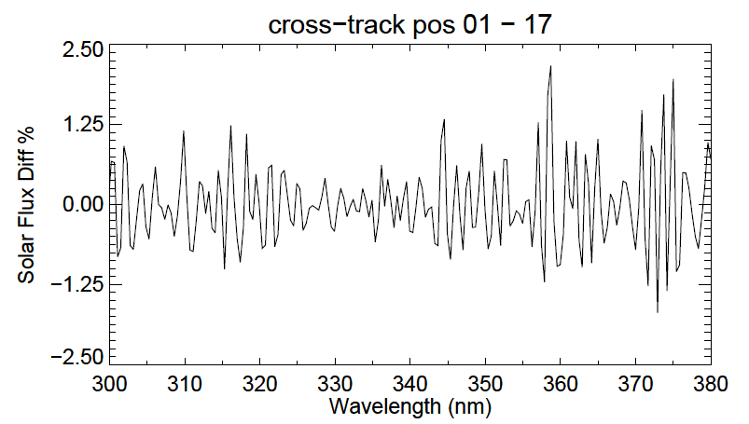
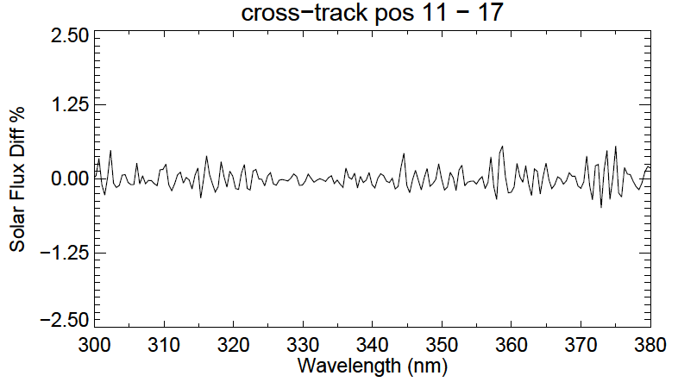
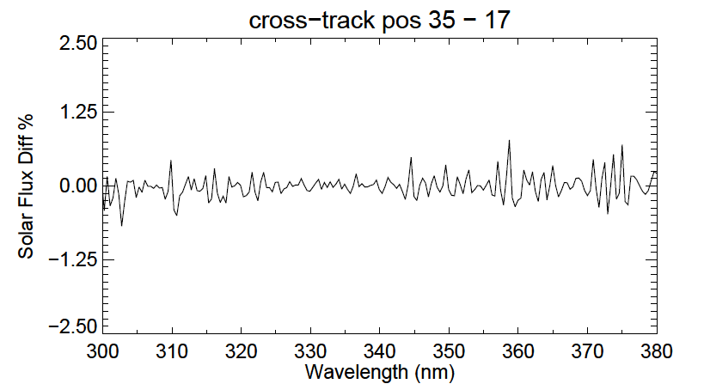
Solar Irradiance (Flux) Cross-Track
Difference for NM
Wavelength Dependent Cross-Track Solar Irradiance Error Was Eliminated
Previous wavelength LUT cause errors in cross-track position.
Irradiance error is percent difference between observed solar flux and modeled solar synthetic flux.
Figures show the errors for 6 different cross-track position relative to the nadir position
Updated wavelength and solar flux LUTs have eliminated cross-track irradiance error .
Up to 2.5 -3.0 % improvement has been achieved
Updated wavelength LUT eliminates errors in cross-track position.
Solar irradiance error in cross-track direction is eliminated.

Slide 24
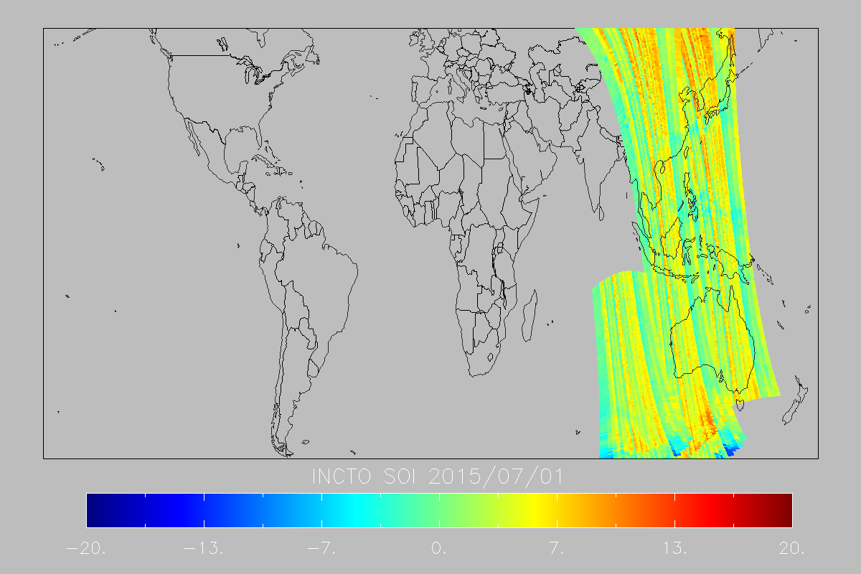
SO2 Index Comparison before and after Wavelength Update
Reduced Cross-Track Dependence in
OMPS NM Derived EDR (SO2)
SO2 index cross-track variation was minimized from -15 ~ 13 to 6~7.
Residual error are caused by EDR V7 TOZ algorithm, that inappropriately exaggerates the impact of wavelength variation.
The residual error can be corrected by EDR V8 algorithm with an appropriate n-value adjustment.
Data comes from OMPS NM EDR products INCTO SO2 2015/07/01
Previous data
Updated data
-20 -13 -7 0 7 13 20

Slide 25
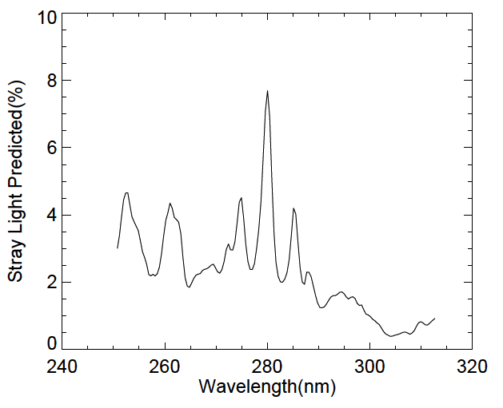
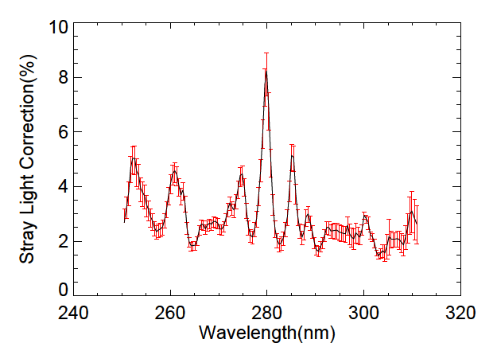
Improved OMPS NP Stray-Light Correction (1/2)
Prelaunch predicted SL contamination
Orbital 19048 corrected SL contamination
Example of orbital stray light correction vs. prelaunch predicted value shows
that the orbital stray light correction is adequate across all the wavelengths

Slide 26
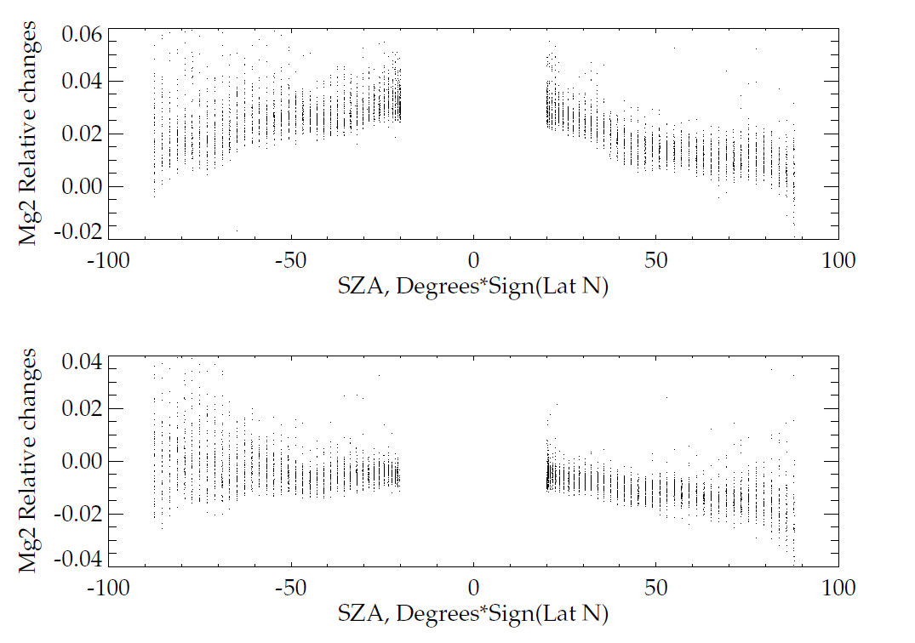
Improved OMPS NP Stray-Light Correction (2/2)
Earth-view Mg II Index for March 2014
Change in EV Mg II index reflects stray light correction.
Mg II index varied with SZA before the NP stray light correction. Stray light contamination caused up to -1. ~ 5.% errors in EV radiance
The errors are within ±2% for the most of the channels after stray light correction was applied.
Before stray light correction
After stray light correction
Solar azimuth angle dependent correction residual is caused primarily by the ring effect.

Slide 27
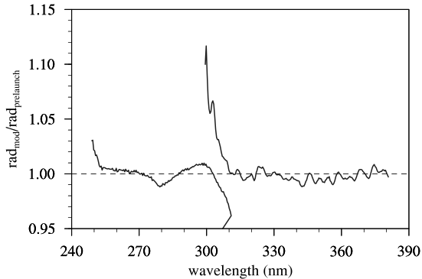
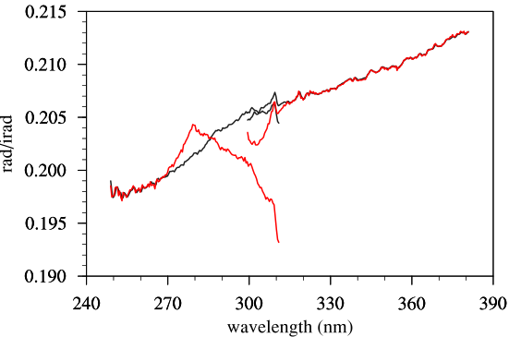
Additional Improvement in Radiometric Calibration (1/2)
Radiance/irradiance coefficients were modified to account for ground to orbit wavelength shifts, as well as normalized radiance consistency between NP and NM
Updated day-one solar LUT accounts for updated irradiance cal coefficients.
Ratio Radiance before/after Updates
Normalized Radiance: rad/irad
NP
NM
NM
NP
Original LUT
Updated LUT
Updated radiance coefficient LUTs improve normalized radiance consistency up to ~10% between NP and NM in 300-310 nm.

Slide 28
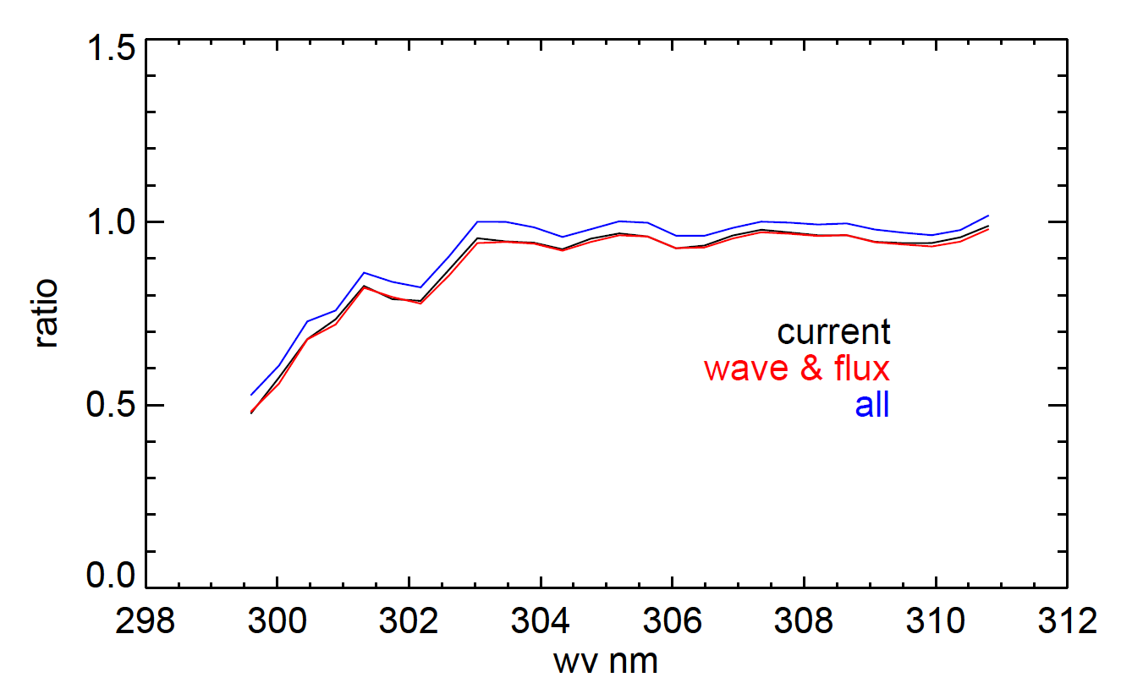
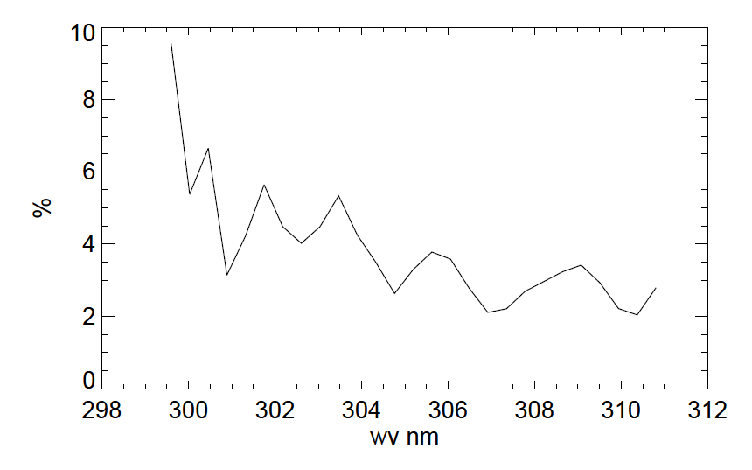
Additional Improvement in Radiometric Calibration (2/2)
Improvement in the Spectral Range of 300 - 310 nm
Radiance ratio of NP/TC
Radiance ratio of NP/TC
Percent difference (1-v0/v2)*100
before and after LUTs update
V0
V1
V2
The improvement was validated via SDR products from both NP and NM.
EV Radiance from NP and NM are collocated spatially and spectrally
1174 granules (globe coverage) were used for validation
Radiance is computed via old LUTs (V0), updated wavelength & day one solar (V1) and updated wavelength, day one solar, radiance/irradiance LUTs (V2)
NM & NP consistency in SDR radiance is improved by ~2-10%.

Slide 29
Monitoring OMPS Solar Diffuser Degradation
Sensor optical degradation < 1.0 %.

Slide 30
OMPS Solar Irradiance Errors Measured
from Solar Diffusers
Errors from work diffuser measurements
Errors from Reference diffuser measurements
Channels with large noise
Irradiance error meets the requirement of 7% for most of the channels.

Slide 31
OMPS System Nonlinearity
System nonlinearity meets the requirement of 2%.

Slide 32
Sensor Signal to Noise Ratio from EV data
Data collected from 1178 EV granules on July 1, 2015
Equivalent to SNR 1000
Sensor signal to noise ratio from EV data meets the requirement of 1000.

Slide 33
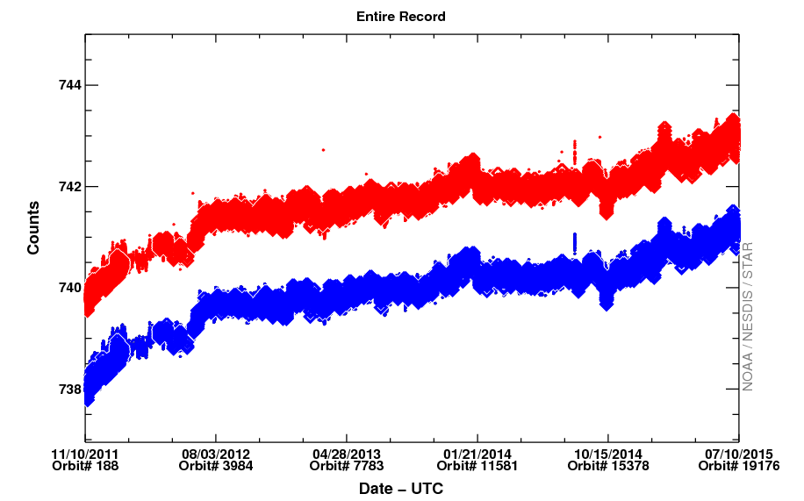
OMPS Solar Diffuser Count Drafts
NP
NM Left CCD
Bias drifts are small for both sensors. Sometime, unexpected bias drifts are observed, but do not have negative impact on the SDRs since the magnitudes in general are small.

Slide 34
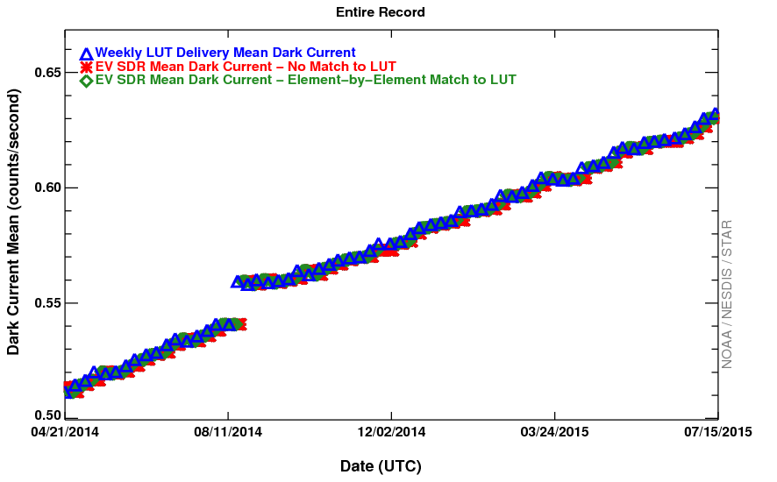
OMPS Dark Current Trend
Dark data shows a bump-up trend after the spacecraft maneuver.
NM slowly returns to the original trend and the change rate is slowing down
NP has a static offset of 8.1e⁻³ count/sec in mean dark and parallel
with the original trend.
Dark increases as expected. Dark changes have no significant impact on SDRs.

